Slide 1
VG101Jigang MID1 REVIEW
Wang Kaibin

Slide 2
MATLAB – HOW TO SOLVE A PROBLEM
The first step - Structural Construction
Write structural parts in comments
Write empty subfunctions and realize the subfunctions later
Example: Manuel’s P1 – Crossroad (It was a mid1 several years ago)

Slide 3
MATLAB – HOW TO SOLVE A PROBLEM
What should the program do?
Input the arguments.
Run the animation – We need to separate it further
Show the plate of crashed cars

Slide 4
MATLAB – HOW TO SOLVE A PROBLEM
How could we run the animation continuously? – Use loop.
Generate new car – if there is the need
Update the traffic light – if time has passed
Update the position of the cars
Collision check – update loop end condition
Draw cars
Wait some time

Slide 5
MATLAB – HOW TO SOLVE A PROBLEM
How to construct your hw2 like this?

Slide 6
MATLAB – HOW TO SOLVE A PROBLEM
How to construct your hw2 like this? An intuitive idea
Do add calculation – if there is add operator
Do minus calculation – if there is minus operator
Do multiplication calculation – if there is multiplication operator
Do division calculation – if there is division operator
What if there is a negative sign?

Slide 7
MATLAB – HOW TO SOLVE A PROBLEM
How to construct your hw2 like this? Update negative sign
Do add calculation – if there is add operator
Do multiplication calculation – if there is multiplication operator
Do division calculation – if there is division operator
Do minus calculation – if there is one minus operator
Jump one operator and do minus calculation – if there are two minus operators

Slide 8
MATLAB – HOW TO SOLVE A PROBLEM
Consider a step in this program.
How to calculate a certain operation?
Find this operator
Get the numbers before and after the operator
Calculate
How to get this number?
Get the substring that represents the number – use matrix manipulation
Change the substring to double – use str2double

Slide 9

MATLAB – Trouble shooting
How to tell the type of error by error message?
We could monitor fid and see
That means the action to open the file is a failure; the file may not exist.
Wrong usage of fread, file identifies is invalid. Please use fopen to generate effective file identifier.

Slide 10

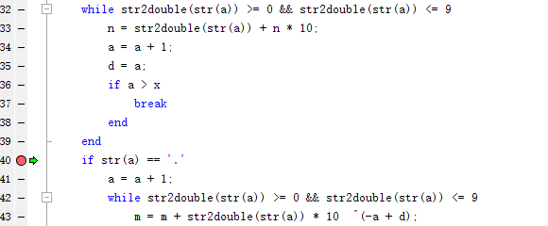
MATLAB – Trouble shooting
How to tell the type of error by error message? – general procedure
Track the erroneous code.
Track the value of erroneous variable.
View the context of erroneous code.
What’s the problem? What will happen
If there is no ‘.’ in the string?

Slide 11
MATLAB – Trouble shooting
How to generate testcases? – classification of testcase
Simple testcase. Example, ‘1+1’ in myeval
Boundary testcase. Example, 74 200, in BMI
*Nonsense testcase. Example, ‘kahdfkjahfoiash’ in myeval

Slide 12
MATLAB – Trouble shooting
How to generate testcases? – generate effective simple testcases
Find the constraints of question. Example, (+,-,*,/,minus sign, decimal point) in hw2
Generate corresponding testcases to the constraints. Example,
Test these testcases and compare with the correct answer to find your bugs.
For ‘+’, we could generate 1+1.
Combine ‘+’ ‘minus sign’ and ‘decimal point’, we could generate ‘-1.5*2.3’

Slide 13
MATLAB – Trouble shooting
How to generate testcases? – boundary conditions and boundary testcases
Numeric boundary. Example, 32767 and -32768 in signed int 8; 65535 in uint8
Constraint boundary. Example, 0 in numeric processing problems
Step functions. Example, 70, 210 in BMI calculation (BMI = 18.5)
Size limitations. Example, in
Draw a circle of radius R in a 250 * 250 bitmap.
R = 0 and 250 is boundary conditions.

Slide 14
MATLAB – Trouble shooting
How to massively apply testcases? – automatic testing machine
Generate testcases.
Store them in arrays, and calculate the results by yourself, store them to another array.
Use for loop to test your function through all the testcases and record the bugs.

Slide 15
MATLAB – Trouble shooting
How to massively apply testcases? – How to handle exceptions?
try
…
catch ex
…
end

Slide 16
ANY QUESTIONS?

